Slide 1
Statistics in Data Science

Slide 2
Topics
Statistics
Variables & Types
Frequency Distribution
Measures of Central Tendency
Mean, Median and Mode
Measures of Dispersion

Slide 3
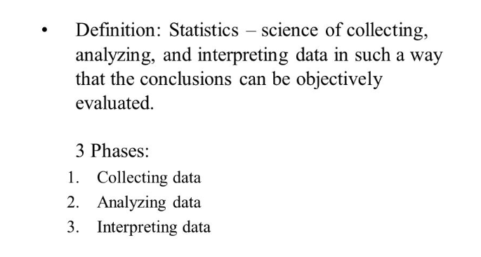

Slide 4
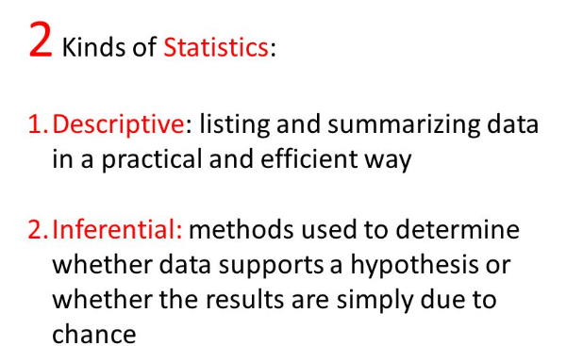

Slide 5
Descriptive Statistics
Measures of Central Tendency
Measures of Dispersion
Density functions (Probability, Density)
Distributions (Gaussian, LogNormal, Binomial, Bernoulli etc)
Transformation and Standardization

Slide 6
Inferential Statistics
Z test
T test
ANOVA
Chi square
Hypothesis Testing (p value)
Confidence Interval

Slide 7
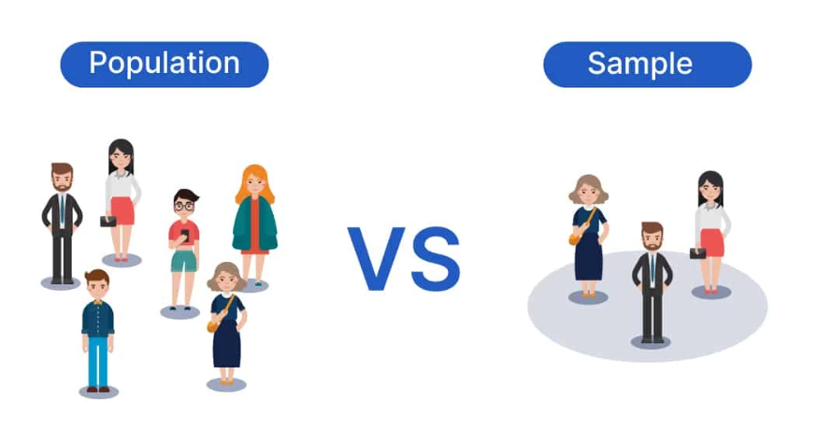

Slide 8
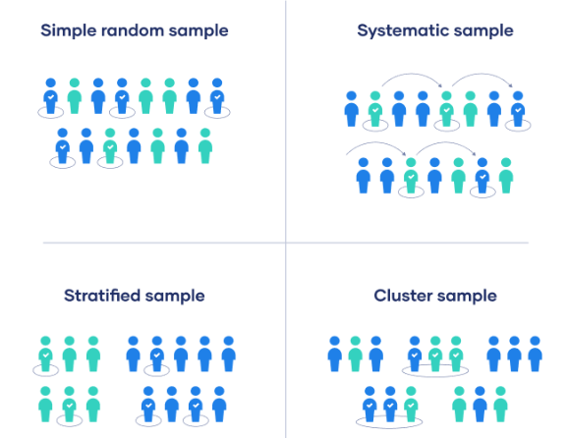
Sampling Techniques
/Convenient Sampling

Slide 9
Which sampling would be better?
Exit Poll ?
RBI Household survey?
Drug testing?

Slide 10
Variables
It is a property which can take any value.
Ex- weight, height
Two kinds of variables-
Quantitative - age, height etc.
Discrete :Number of credit cards a person have, number of windows in your room
Continuous : height, weight etc.
Qualitative/Categorical - gender, profession etc. (based on some characteristic, these categories are derived)

Slide 11
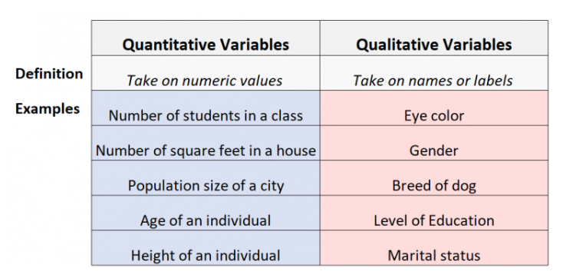
Quantitative and Qualitative Variables

Slide 12
Find the variable type?
Song duration?
Length of the river?
Daily usage of instagram?
Population of a state?
Pincode?

Slide 13
Measurement of Variable / Variable Measurement Scales
Nominal : categorical/qualitative , no order in this data
Ex- gender, color, type of flower etc
Ordinal : value doesn’t matter here but the order/rank
Student | Rank
100 | 1
90 | 2
77 | 3

Slide 14
3. Interval : value also matters and order as well, no meaningful 0.
Ex - temperature interval
70-80 80-90 90-100
4. Ratio : value and order matters here and there is a meaningful 0 here.
Ex - age

Slide 15
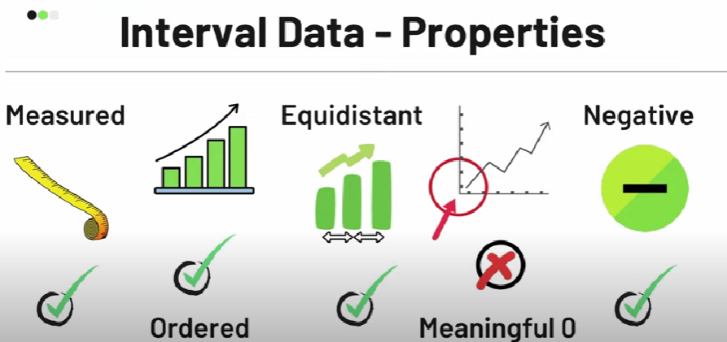
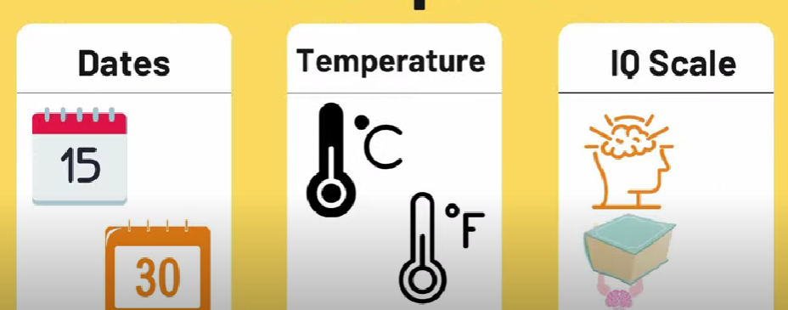
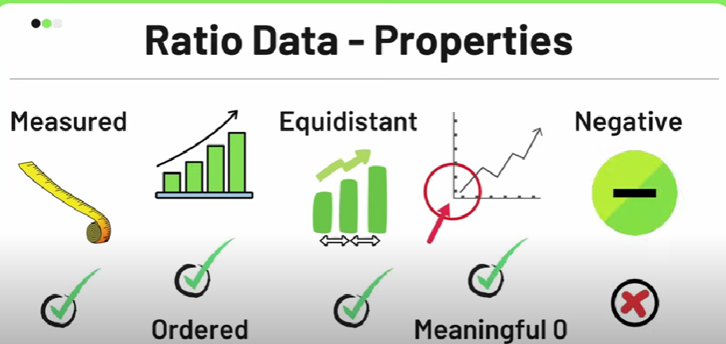
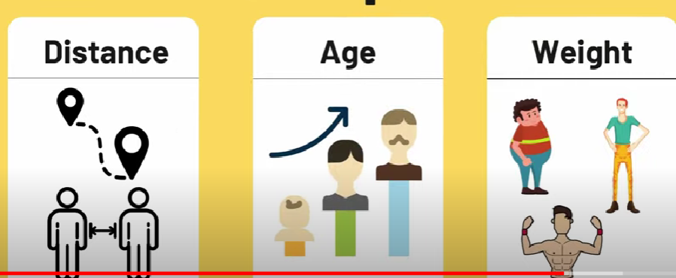
Notes:
Interval: rank and order, 1degree<3degree celsius, difference between 5 and 6 is same as 7 and 8.
Ratio: 2km <3 km, meaningful 0, can never be negative,

Slide 16
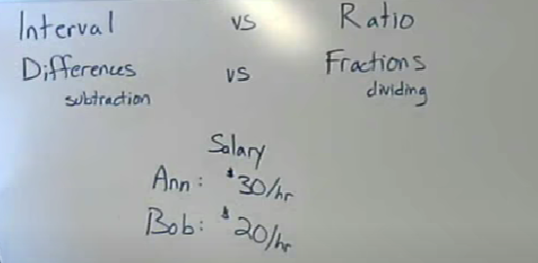

Slide 17
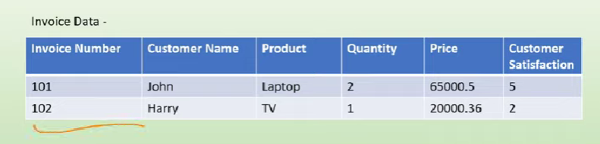
Find the variable type?

Slide 18
Find the variable type?
Invoice : Nominal Quantity: Discrete (Quant)
Customer Name : Nominal Price : Continuous (Quant)
Product : Nominal Customer Satisfaction: Ordinal(Quanti)

Slide 19
Frequency Distribution: Categorical Variable
Sample dataset:
Audi, Benz, Benz, Benz, Audi, KIA, Audi, Benz, Audi, Audi, KIA
Audi : 5
Benz : 4
KIA : 2
Cars | Frequency
Audi | 5
Benz | 4
KIA | 2

Slide 20
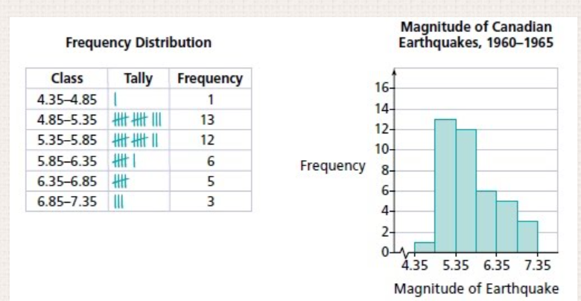
Frequency Distribution : Continuous Variable

Slide 21
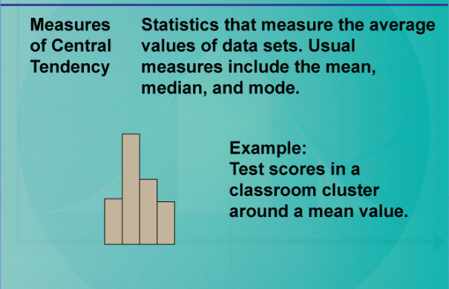
Measures of Central Tendency

Slide 22
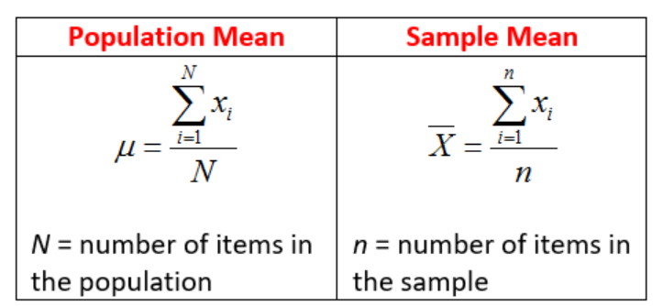
Mean

Slide 23
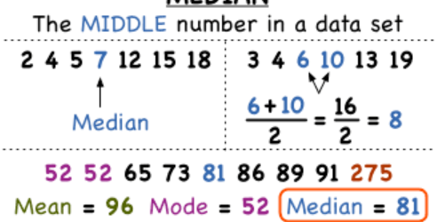
Median

Slide 24
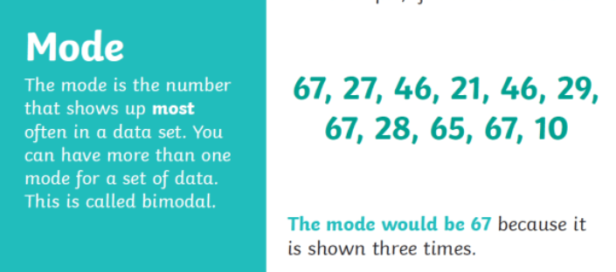
Mode

Slide 25
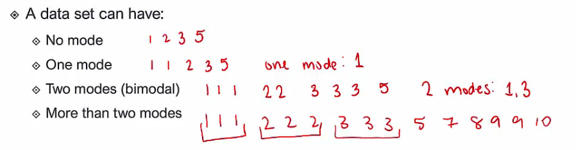

Slide 26
What to use, Mean, Median or Mode?
Missing data in the following datasets
Missing flower name in the dataset?
Age of students in a classroom
Missing hobby in a dataset for employees of a company

Slide 27
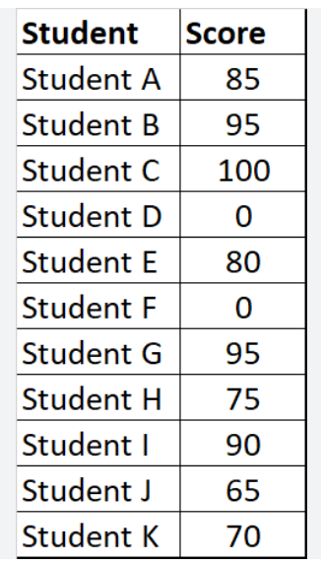
0,0,65,70,80,85

Slide 28
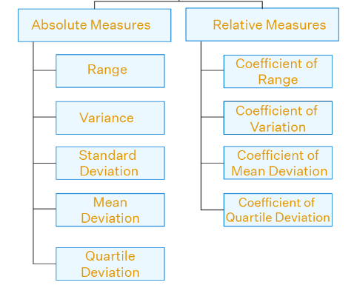
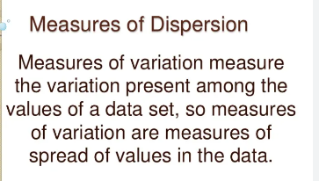
Measures of dispersion

Slide 29
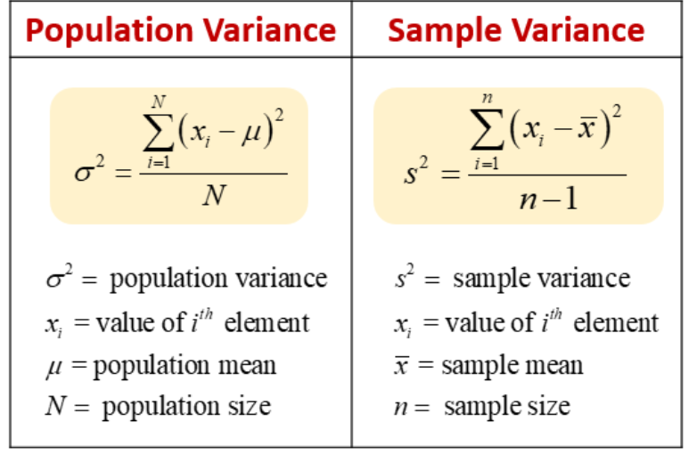
Variance
V. Important : Population variance and sample variance

Slide 30
Calculating Variance
x | µ (Mean) | x-µ (Mean deviation) | (x-µ)2
1 | 2.83 | 1-2.83 | -1.83^2
2 | 2.83 | 2-2.83 | -0.83^2
2 | 2.83 | 2-2.83 | -0.83^2
3 | 2.83 | 3-2.83 | 0.17^2
4 | 2.83 | 4-2.83 | 1.17^2
5 | 2.83 | 5-2.83 | 2.17^2
Total = 0.01999/6 = variance

Slide 31
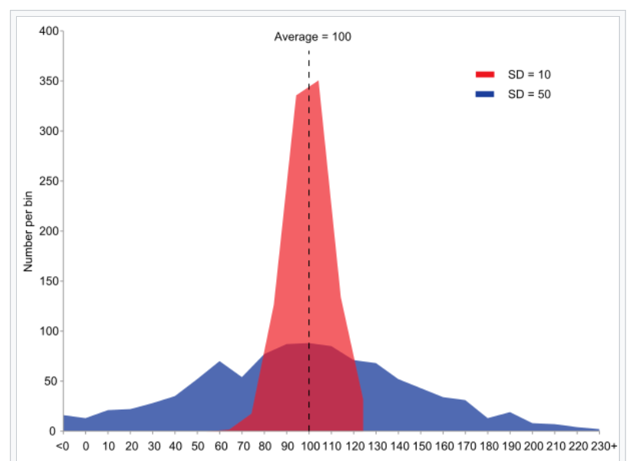

Slide 32
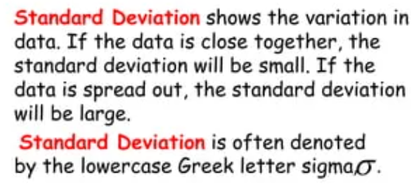
Standard Deviation

Slide 33
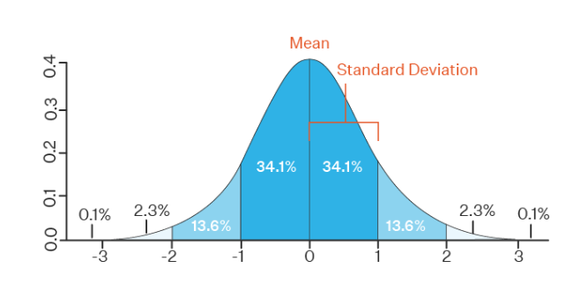
Standard Deviation

Slide 34
Finding Outliers : Percentiles and Quartiles
Question: Find the % of the numbers which are div by 6?
Numbers = 4,8,12,16,20,24,28
Percentage = ? 2/7*100
Dataset=2,2,3,4,5,5,5,6,7,8,8,8,8,8,9,9,10,11,11,12
What is the percentile rank of 10?

Slide 35
Number of values below 10/n X 100
16/20 X 100 = 80%
Dataset=2,2,3,4,5,5,5,6,7,8,8,8,8,8,9,9,10,11,11,12
What is the percentile rank of 8? 9/20 x100
What value exists at percentile ranking of 25%?
Value = Percentile/100 X (n+1) [Gives you the index position not the exact value]
What value exists at percentile ranking of 75%?
Value = 75/100 * 21

